Slide 1
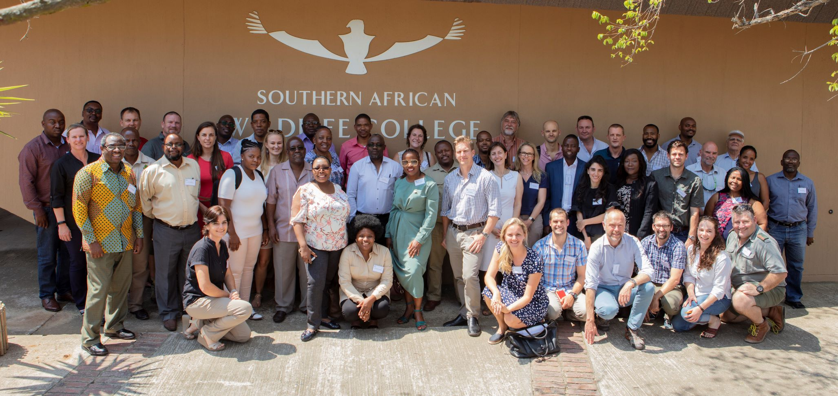
SADC TFCA Network Long-term Sustainability
Transboundary Use and Protection of Natural Resources (TUPNR) | 24 April 2019
Lisa Blanken – TFCA Network Adviser, GIZ

Slide 2
TUPNR Programme overview
Programme Objective: To improve the implementation of SADC protocols and strategies for sustainable natural resource management in Trans-frontier Conservation Areas (TFCAs) by local, national and regional actors.
6/2015 – 12/2020
Budget 12.5 Mio €, BMZ
9 Staff
Multi level approach: activities on regional → national → local level
Focus policy documents where implementation is supported:
  SADC TFCA Programme (2013)
  SADC Law Enforcement and Anti-Poaching Strategy (2015)
  SADC Tourism Programme (under development)

Slide 3
Components of work
Strengthen the role of the SADC Sec. in implementing SADC Protocols, Strategies and Programmes for TFCAs and NRM
Initiate processes to improve national frameworks through TFCA focal points
Support regional learning through the development and institutional strengthening of the SADC TFCA Network
Improve transboundary cooperation in 3 selected TFCA (Ai/Ais/ Richtersveld, Lubombo & Malawi-Zambia)
Cross-cutting components: LEAP and Tourism

Slide 4
Implementation Approach
Dev. of new regional standards and policies: LEAP, TFCA M&E System, SADC Guidelines, MEAs (CITES, CBD), Tourism
Regional
Support TFCA practitioners through increased sharing of information and
regional learning
Capacity Development for domestication of SADC policies and standards
National
TFCA Network
Testing new Models: Cross-border Governance, Income Generation, Tourism Development
TFCA
Parks – Communal Land – Pvt. Land

Slide 5
TFCA Network long-term sustainability study
GIZ provides significant resources and assistance to establish it
  Some support from other donors (PPF, WWF etc)
  Funding runs out by December 2020
TFCA Network elements GIZ supported
TFCA Portal (Website + Intranet)
TFCA Network Facilitation/Coordination
Annual TFCA Network/SC meetings
CoPs
Staff: Technical Adviser – TFCA Network
Technical Committee on Wildlife meetings
Participation at international events (CITES, CBD)
Development of SADC TFCA Guidelines

Slide 6
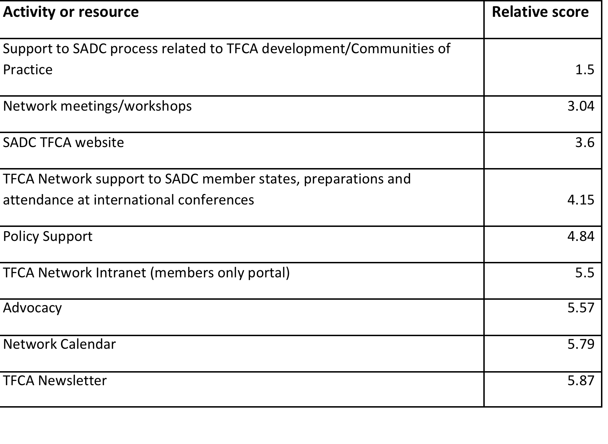
Network satisfaction survey

Slide 7
Important Network elements for continuation
Critical
Less essential
Grow the membership
The Portal & website
The ‘warm body’
The Steering Committee (SC)
Est €60 to €75K pa
Communities of Practice (CoPs)
Workshops and meetings
Intl events
Top-up (€75 to €120K pa)

Slide 8
Funding options coming out of the TFCA Network long-term sustainability
The Base | At least appoint a person Tasks include all the critical Likely costs €60k per year
Middle of the Road | Base Scenario plus Warm body secures ad-hoc funding for additional workshops, guidelines etc. Fewer activities Operating costs €100k to €130k per year
Best case | The Full Monty as per current €180k to €200k per year or maybe more

Slide 9
Itemised costing per network function
PDF document

Slide 10
Avenues for secure funding to the Network
Continue with grant/donor funding by ICPs or NGOs – Most likely
Membership fees (around 200 EUR is required on a minimum) – Unlikely
A fee per SADC Member State – Highly unlikely
SADC funds directly – as one of their core functions – Unlikely

Slide 11
Recommendations
The SADC TFCA Network Steering Committee requests SADC Secretariat to engage with USAID and IUCN BIOPAMA to secure funding for the Network beyond 2020;
Request SADC Secretariat to negotiate a Memorandum of Understanding (MoU) with PPF which includes regional support to TFCAs (a warm body for the Network) as well as deliberate on taking over the virtual aspects of the TFCA Network functions;
Linked to the discussions with IUCN as implementing body of the TFCA Financing Facility, request SADC Secretariat to ensure that network activities are incorporated within the work plan of the existing MoU;
Request SADC Secretariat to negotiate with WWF to ensure that network activities are incorporated within the work plan of the existing MoU; and
Based on the outcome of the funding negotiations, the SADC TFCA Network Steering Committee requests SADC Secretariat to engage with all possible partners and negotiate the most sustainable option for continuation of the Network.

Slide 12

Thank you!

